Slide 1
CALCULATING UNCERTAINTY FOR R0
UNCERTAINTY QUANTIFICATION
Project 1 Presentation 2021/22
School of Mathematics Sciences
University of Nottingham
PRESENTED BY
JAKE DENTON & ARCHIE BOSWELL

Slide 2
CONTEXT
01
BACKGROUND
02
MODEL AND DATA
03
METHODS
04
RESULTS
05
LIMITATIONS
06
RECOMMENDATION

Slide 3
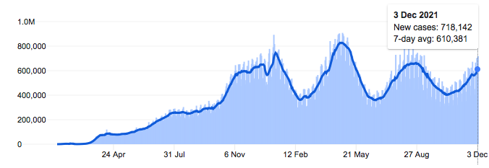

BACKGROUND
WHAT IS OUR AIM?
WHAT IS COVID-19?
First identified December 31st 2019 in Wuhan City, China.
Considered a global public health concern on January 30th 2020
Vaccine found November 9th 2020
8 known variants
To date: 265 M cases with 5.24 M deaths
Our overall aim is to advise SAGE on the relaxation of COVID-19 restrictions based on the basic reproductive number R0.
HOW HAVE WE ACHIEVED THIS?
Fit the Susceptible-Exposed-Infected-Removed (SEIR) epidemic model to daily cases data.
Use methods to predict the parameter values.
Estimate R0:
Calculate the uncertainty of R0
Provide recommendation and discuss further analysis that might be required in order to make the most sensible decision.
$$R0=infection rate × average infectious period$$
$$R0=\frac{β}{γ}$$
[FIGURE 1: NUMBER OF CASES OF COVID-19 WORLD WIDE SINCE 24th JANUARY 2020]

Slide 4









MODEL & DATA
SEIR MODEL:
SEIR stands for susceptible, exposed, infected and recovered.
N is the sum of all living members in the population: $N= S+E+I+R$
D is the dead whilst C is the cumulative number of cases.
INITIAL CONDITIONS:
SEIR MODEL
$$\frac{dS}{dt}=−\frac{βSI}{N}$$
$$\frac{dE}{dt}=\frac{βSI}{N}−σE$$
$$S\left(0\right)= N−1, E(0)= 0, I(0)= 1, R(0)= 0, D(0)=0, C(0)=1$$
$$\frac{dI}{dt}=σE−γI$$
PARAMETERS USED:
$β=Infection rate (days)$
$\frac{1}{γ}=Average time someone is infectious (days)$
$\frac{1}{σ}=Average incubation time \left(days\right)$
$p=Death rate (days)$
$$\frac{dR}{dt}=(1−p)γI$$
$$\frac{dD}{dt}=pγI$$
ASSUMPTIONS:
CUMULATIVE NUMBER OF CASES:
Population remains constant
The recovered are permanently immune
Parameters are constant in time
Susceptible people remain susceptible until infected
Equal chance of becoming infected across the population
$$\frac{dC}{dt}=σE$$

Slide 5
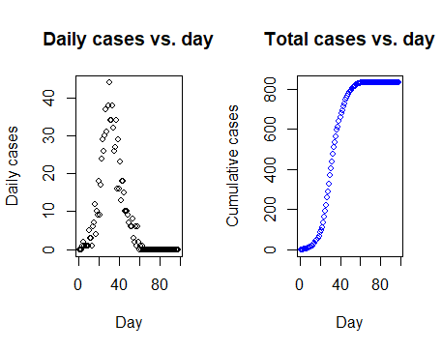
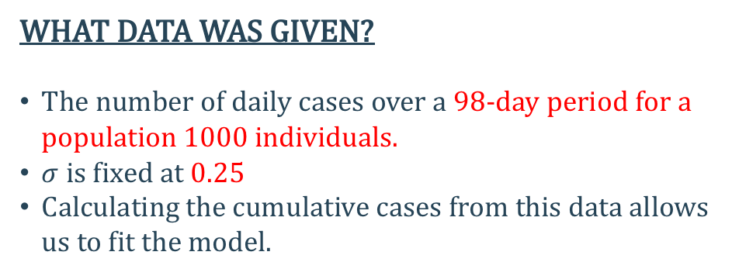
MODEL & DATA
WHAT DATA WAS GIVEN?
The number of daily cases over a 98-day period for a population 1000 individuals.
$σ$is fixed at 0.25
Calculating the cumulative cases from this data allows us to fit the model.
EXPLORATORY ANALYSIS:
Sharp increase of cases proceeding day 10
Peak occurred on day 30 with 44 cases
Daily cases fall at a similar rate
50% of the population infected in 13 days
Last recorded infection on day 63
83.1% of the population was infected
[FIGURE 2: PLOT ON LEFT SHOWS DAILY CASES OVER THE PERIOD. PLOT ON RIGHT SHOWS CUMULATIVE NUMBER OF CASES]

Slide 6

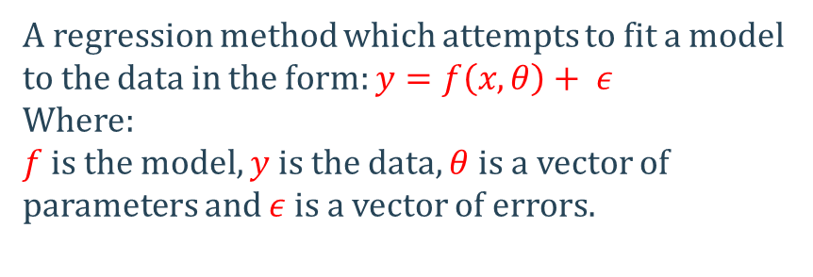
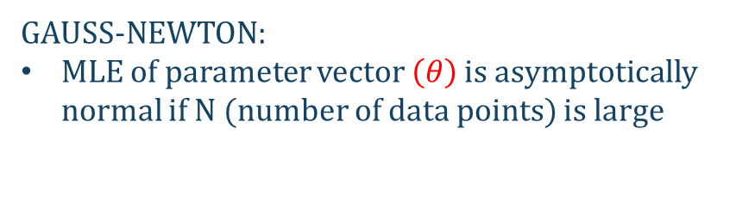

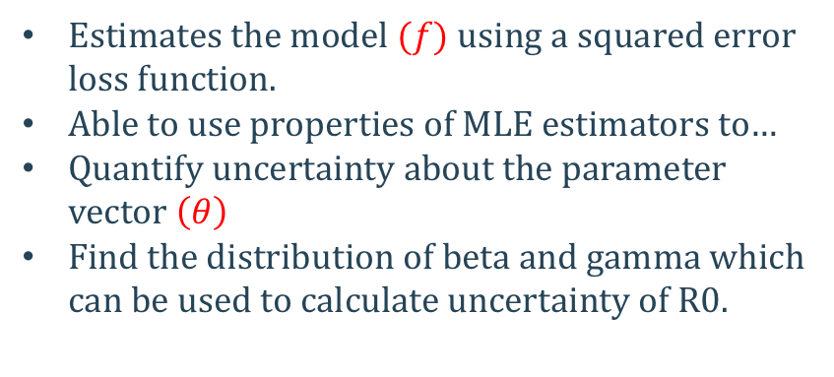
METHODS- NON-LINEAR REGRESSION
WHY NON-LINEAR REGRESSION?
We fit non-linear regression models to the data, which utilises the Gauss-Newton algorithm.
Estimates the model $(f)$ using a squared error loss function.
Able to use properties of MLE estimators to…
Quantify uncertainty about the parameter vector $\left(θ\right)$
Find the distribution of beta and gamma which can be used to calculate uncertainty of R0.
WHAT IS NON-LINEAR REGRESSION?
A regression method which attempts to fit a model to the data in the form: $y=f\left(x,θ\right)+ ε$
Where:
$f$is the model, $y$is the data, $θ$is a vector of parameters and $ε$is a vector of errors.
WHAT IS THE GAUSS NEWTON ALGORITHM?
An iterative method which updates initial parameter values and continues until convergence.
ASSUMPTIONS:
NON-LINEAR REGRESSION:
$ε$ is normally distributed
$ε$ is independent
$ε$ has mean 0
Initial parameter estimates:
$$\left(β,γ,p\right)=(0.5, 0.25, 0.05)$$
We approximate the solution using the Runge-Kutta method, which has a high order of accuracy.
GAUSS-NEWTON:
MLE of parameter vector $\left(θ\right)$ is asymptotically normal if N (number of data points) is large

Slide 7
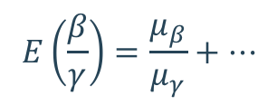
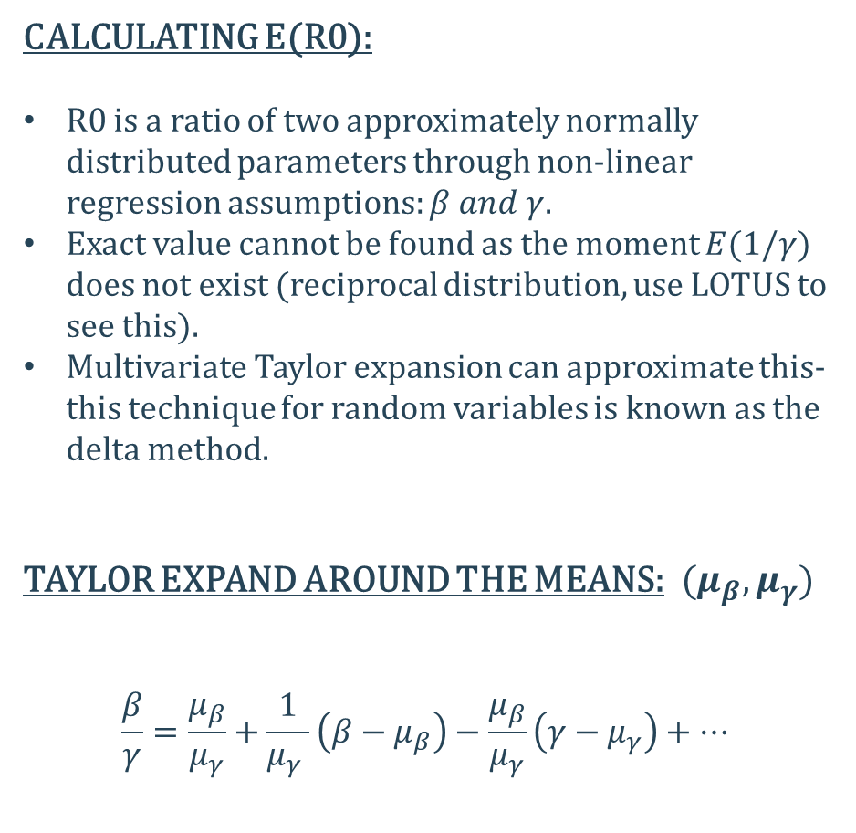
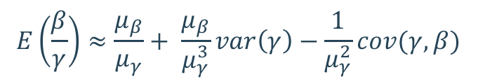
METHODS – R0 DISTRIBUTION
CALCULATING E(R0):
R0 is a ratio of two approximately normally distributed parameters through non-linear regression assumptions: $β and γ$.
Exact value cannot be found as the moment $E(1/γ)$ does not exist (reciprocal distribution, use LOTUS to see this).
Multivariate Taylor expansion can approximate this- this technique for random variables is known as the delta method.
TAYLOR EXPAND AROUND THE MEANS:$(μ_{β},μ_{γ})$
$$\frac{β}{γ}=\frac{μ_{β}}{μ_{γ}}+\frac{1}{μ_{γ} }\left(β−μ_{β}\right)−\frac{μ_{β}}{μ_{γ}}\left(γ−μ_{γ}\right)+…$$
TAKING THE EXPECTATION:
$$E\left(\frac{β}{γ}\right)=\frac{μ_{β}}{μ_{γ}}+…$$
The ratio of the means is the first approximation.
SECOND ORDER TAYLOR EXPANSION:
$$E\left(\frac{β}{γ}\right)≈\frac{μ_{β}}{μ_{γ}}+ \frac{μ_{β}}{μ_{γ}^{3}}var\left(γ\right)−\frac{1}{μ_{γ}^{2}}cov(γ,β)$$
Gives a more accurate approximation

Slide 8

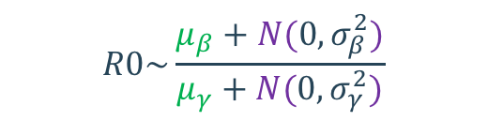
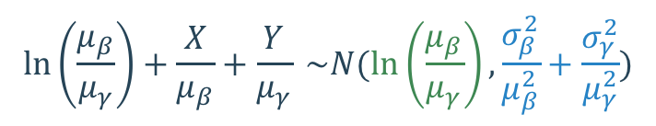

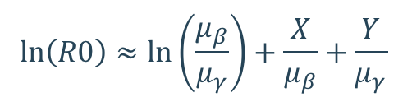
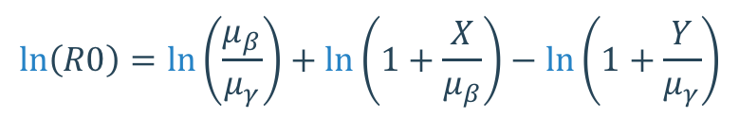
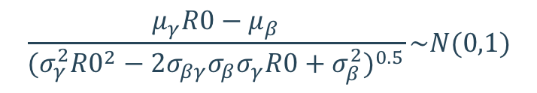
METHODS – CONFIDENCE INTERVAL
Katz and Geary studied the distribution of the ratio of two non-central, correlated normal random variables.
Using the Taylor expansion of $\ln\left(1+δ\right)$,$\left(δ≪1\right):$
$$\ln\left(R0\right)≈\ln\left(\frac{μ_{β}}{μ_{γ}}\right)+\frac{X}{μ_{β}}+\frac{Y}{μ_{γ}}$$
$$\ln\left(\frac{μ_{β}}{μ_{γ}}\right)+\frac{X}{μ_{β}}+\frac{Y}{μ_{γ}} \sim N(\ln\left(\frac{μ_{β}}{μ_{γ}}\right), \frac{σ_{β}^{2}}{μ_{β}^{2}}+\frac{σ_{γ}^{2}}{μ_{γ}^{2}})$$
Split beta and gamma up into sum of their means and zero-mean normal distributions:
KATZ INTERVAL:
$$R0\sim \frac{μ_{β}+N(0,σ_{β}^{2})}{μ_{γ}+N(0,σ_{γ}^{2})}$$
$$R0=exp⁡(\ln\left(\frac{μ_{β}}{μ_{γ}}\right)±z_{\frac{α}{2}}{\left(\frac{σ_{β}^{2}}{μ_{β}^{2}}+\frac{σ_{γ}^{2}}{μ_{γ}^{2}}\right)}^{\frac{1}{2}})$$
$α =significance level$
Rearrange and take the logarithm of both sides:
GEARY INTERVAL:
$$\ln\left(R0\right)=\ln\left(\frac{μ_{β}}{μ_{γ}}\right)+\ln\left(1+\frac{X}{μ_{β}}\right)−ln\left(1+\frac{Y}{μ_{γ}}\right)$$
$$\frac{μ_{γ}R0−μ_{β}}{{(σ_{γ}^{2}{R0}^{2}−2σ_{βγ}σ_{β}σ_{γ}R0+σ_{β}^{2})}^{0.5}}\sim N(0,1)$$

Slide 9
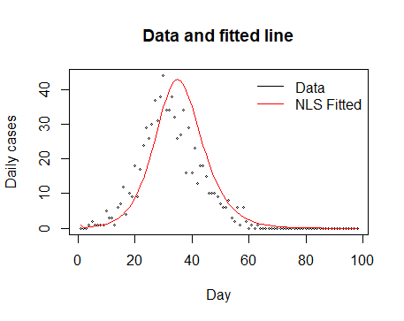

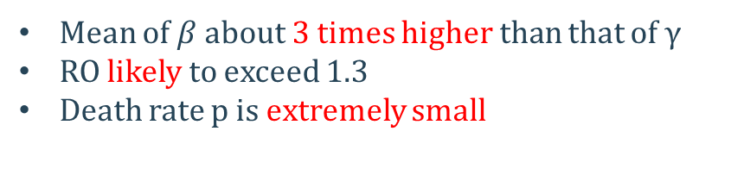
RESULTS
PARAMETERS OBTAINED FROM MODEL:
$$β=0.8991097$$
$$γ=0.3004804$$
$$p=0.0000001$$
Mean of $β$ about 3 times higher than that of $γ$
RO likely to exceed 1.3
Death rate p is extremely small
COVARIANCE MATRIX:
[FIGURE 3: FITTED MODEL AND DATA]
PARAMETER | BETA | GAMMA | P
BETA | 0.011941325 | 0.006158393 | -0.010062125
GAMMA | 0.006158393 | 0.003212934 | -0.005076886
P | -0.010062125 | -0.005076886 | 0.019949790
Red line shows our fitted model:
Tails are well fitted
Peak is below maximum no. of daily cases
Overestimation between day 30 and 50
[TABLE 1- COVARIANCE MATRIX FOR FITTED MODEL]

Slide 10
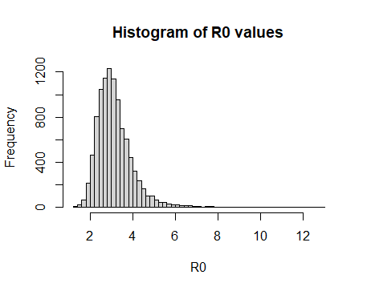
RESULTS
100000 SAMPLES WERE TAKEN:
RO ESTIMATIONS
FIRST ORDER EXPANSION:
RO = 2.992241
SECOND ORDER EXPANSION:
RO= 3.030511
LARGE SAMPLE CONFIDENCE INTERVAL:
(1.972596 , 4.950001)
KATZ CONFIDENCE INTERVAL:
[FIGURE 4: HISTOGRAM OF RO VALUES]
(1.927455 , 4.645249)
Most values lie between 2 and 4
Long tail (ratio distribution)
Only 7 values lower then 1.3
GEARY CONFIDENCE INTERVAL:
(1.974968 , 4.953367)
Covariance matrix of parameters
parameter | beta | Gamma | p
beta | 0.011941325 | 0.006158393 | -0.010062125
Gamma | 0.006158393 | 0.003212934 | -0.005076886
p | -0.010062125 | -0.005076886 | 0.019949790

Slide 11
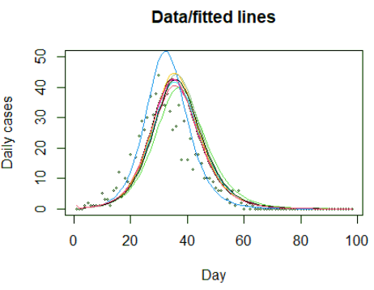
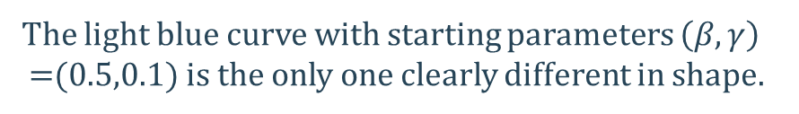
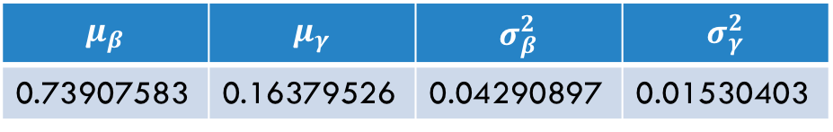
LIMITATIONS
STARTING PARAMETERS:
The light blue curve with starting parameters $\left(β,γ\right)$
=(0.5,0.1) is the only one clearly different in shape.
The choice of starting parameters have a massive influence on the output.
Varied beta and gamma from 0.1 to 1 with a resolution of 0.1.
$$μ_{β}$$ | $$μ_{γ}$$ | $$σ_{β}^{2}$$ | $$σ_{γ}^{2}$$
0.73907583 | 0.16379526 | 0.04290897 | 0.01530403
[TABLE 2- FITTED PARAMETER VAUES AND VARIANCES OF LIGHT BLUE CURVE]
ALL INFECTED INDIVIDUALS SPREAD THE DISEASE AS EFFECTIVE AS ANOTHER:
This is major limitation of the SEIR model.
Doesn’t account for difference between severity of cases.
Doesn’t account for super spreaders.
NOT BEEN TOLD WHERE THE DATA CAME FROM:
Difficult to give recommendations when we don’t know if this sample is representative of the population as a whole.
[FIGURE 5: A COLLECTION OF FITTED MODELS WITH DIFFERENT STARTING PARAMETERS]

Slide 12
RECOMMENDATION
WE ARE VERY CONFIDENT THAT THE THRESHOLD VALUE FOR R0 IS GREATER THAN 1.3
EXTENSIONS:
Based on the histogram and confidence intervals, the vast majority of R0 values were in the range: (1.97, 4.95).
More work can be done to increase reliability of the results- limitations.
Other techniques like: Bootstrapping and Monte Carlo could be used
More sophisticated epidemic models could be investigated
Analysis of larger datasets would help.
Information about the number of hospitalisations would improve advice.
Accounting for the number of daily cases possibly being under-reported due to limits on testing, its likely a larger portion of the population got infected, which would give larger values of R0.
Best estimates for R0 are around 3, which is much greater than 1.3.
References: R.C.Geary. The Frequency Distribution of the Quotient of Two Normal Variates. Journal of the Royal Statistical Society. 93 (3): 442–446. (Geary transformation)
https://en.wikipedia.org/wiki/Ratio_distribution#Gaussian_ratio_distributions (background on Gaussian ratio distributions)

